Slide 1


Slide 2
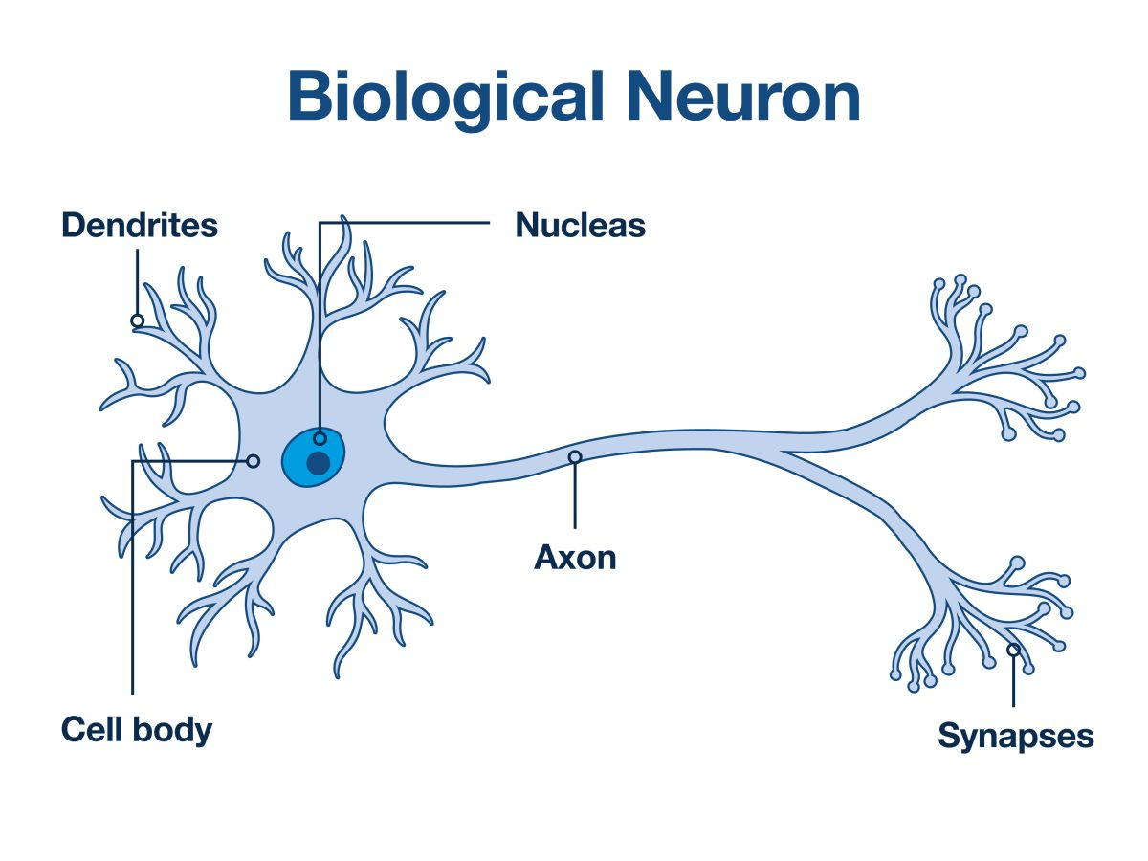

Slide 3
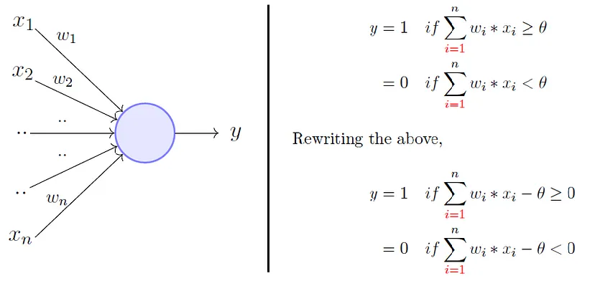

Slide 4
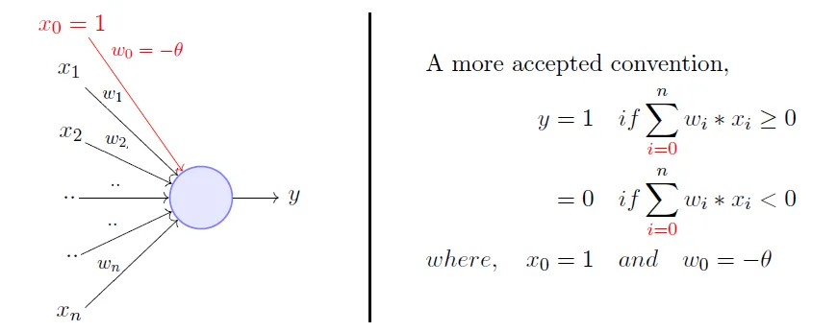

Slide 5
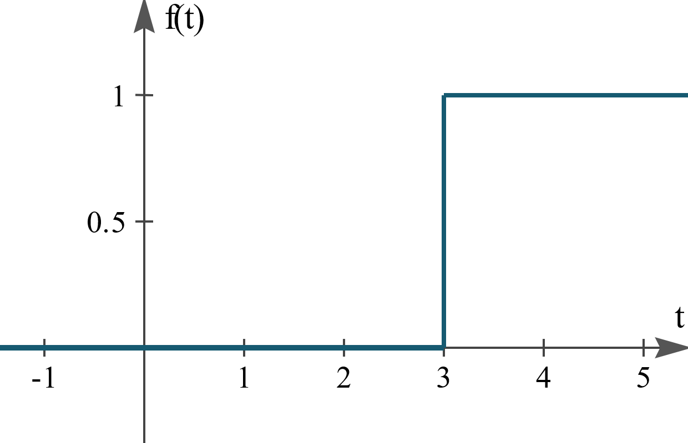
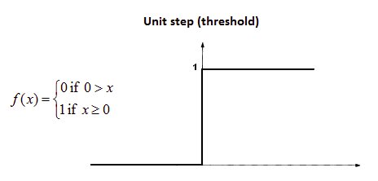

Slide 6
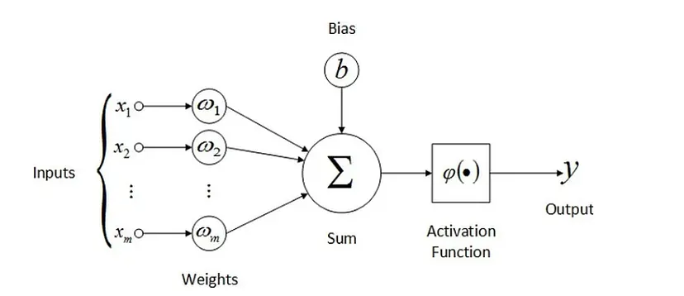

Slide 7



$$\hat{y}=activation(z)$$

Slide 8
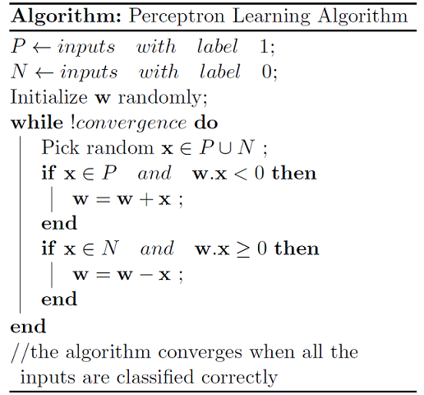


$$w=w+\left(y−\hat{y}\right)x$$
$$w=w+α\left(y−\hat{y}\right)x$$

Slide 9
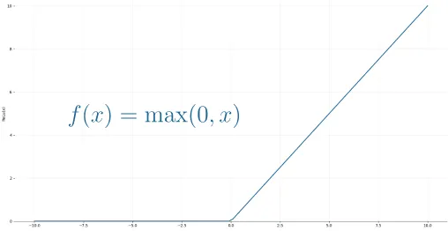

Slide 10
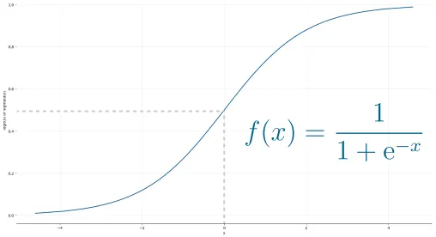

Slide 11


Slide 12






$$−$$
$$−$$

Slide 13
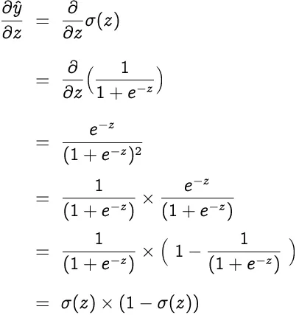

Slide 14
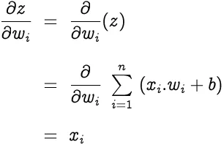




$$−$$
$$−$$

Slide 15
